Slide 1

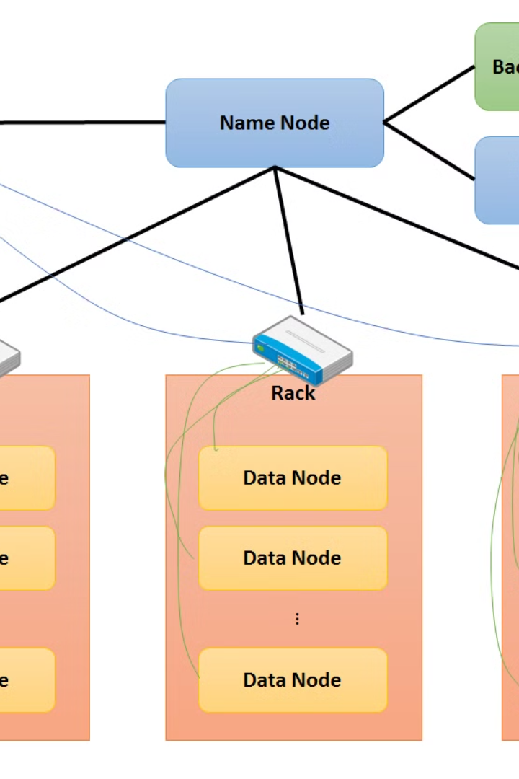

Introduction to HDFS (Storage)
The Hadoop Distributed File System (HDFS) is a distributed file system designed to run on commodity hardware. It provides high-throughput access to data and is suitable for applications with large data sets.
Ma
by Meghana Anantam

Slide 2
Overview of Hadoop Storage File system
Centralized Storage
Fault Tolerance
Parallel Processing
HDFS provides a comprehensive, scalable, and robust solution for storing and managing large volumes of data across clusters of commodity hardware.
HDFS is designed to be fault-tolerant and can recover from hardware failures gracefully, ensuring the integrity and availability of the stored data.
It allows data to be distributed across multiple nodes, enabling parallel processing for faster data access and analysis.

Slide 3
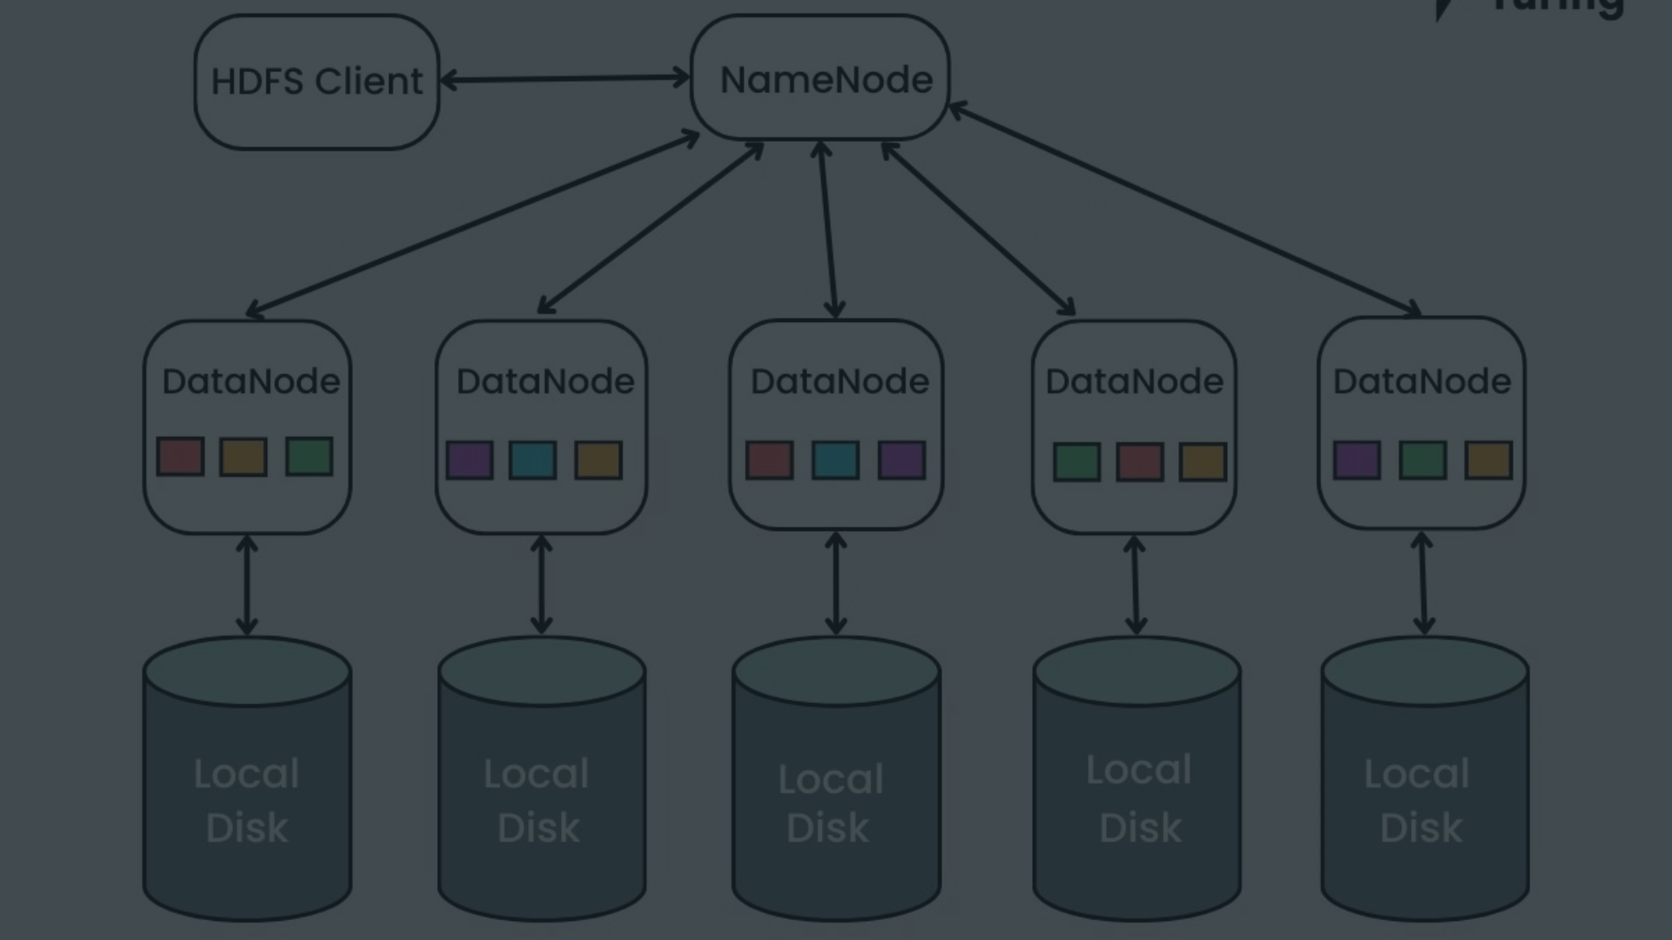
Objective: Creating a directory structure in HDFS
1
Organized Data Storage
2
Logical Data Segregation
The objective is to establish a structured layout for data storage within HDFS, ensuring efficient organization and management.
Creating directories enables logical segregation of data, making it easier to retrieve and process specific datasets when needed.

Slide 4
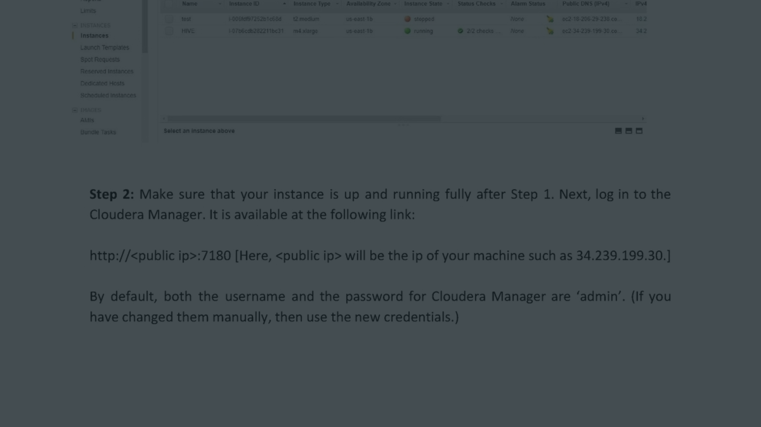
Steps to create a directory structure using HDFS commands
1
Step 1: Login to HDFS
Use the appropriate command to access the HDFS environment and begin the directory creation process.
2
Step 2: Create the Directory
Utilize the command to establish a new directory within the HDFS with the specified name and location.
3
Step 3: Verify the Creation
Confirm the successful creation of the directory by checking its existence and location within the HDFS.

Slide 5

Command 1: Creating a directory
mkdir
Use the "mkdir" command to create a directory in HDFS.

Slide 6

Command 2: Listing directories and files
ls
Execute the "ls" command to list the contents of a directory in HDFS.

Slide 7
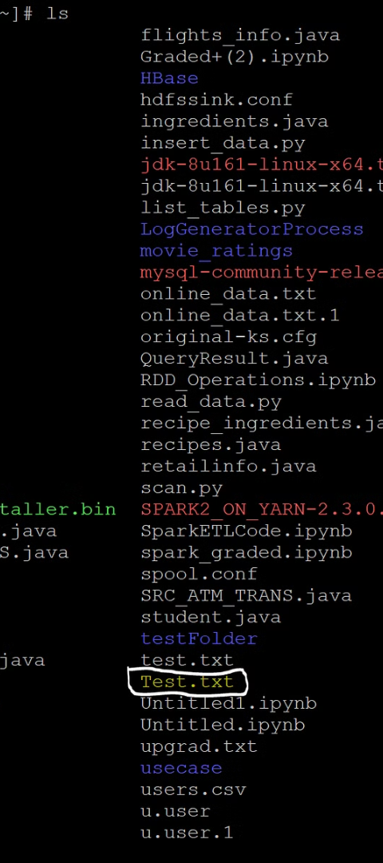



Command 3: Moving files and directories
Step 1: Identify Source
Specify the source path of the file or directory to be moved within HDFS.
Step 2: Define Destination
Designate the destination where the file or directory will be relocated to within HDFS.
Step 3: Execute Move
Execute the appropriate command to initiate the movement of the specified file or directory.

Slide 8
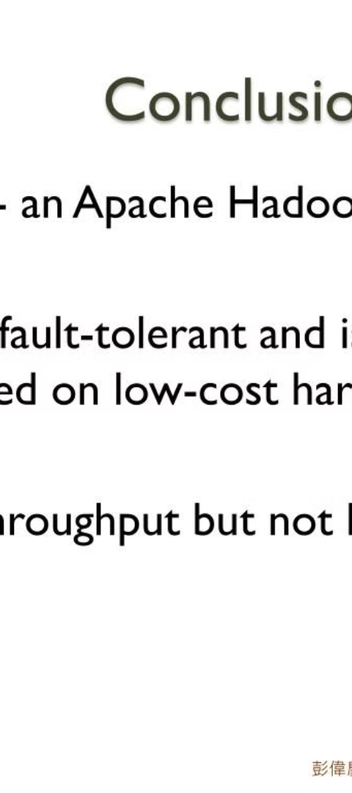
Conclusion
Data Organization
Efficient Data Handling
By understanding HDFS and its command structure, you can effectively organize and manage data within the system.
Mastering HDFS commands enables efficient handling and manipulation of data for diverse analytical tasks.
Scalability and Resilience
HDFS provides scalability and resilience, making it a robust solution for big data storage and processing.

